Slide 1
Lookalikes
Michael Edenborough KC
HGF’s Brand & Design Conference, London
3rd February 2026

Slide 2
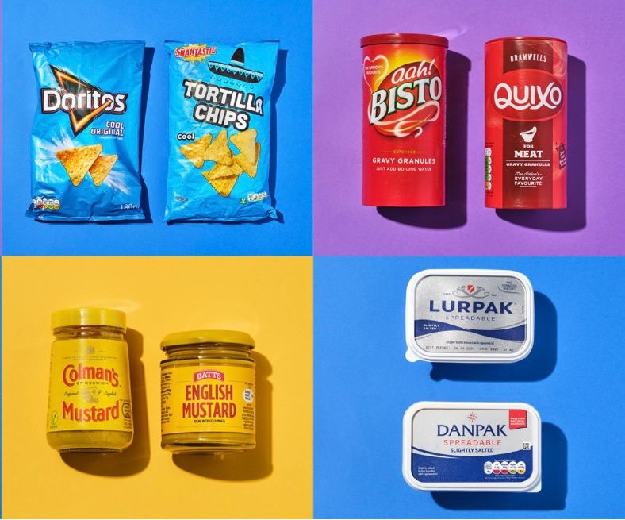
the problem – (un)fair competition
Geoff Steward of Addleshaw Goddard
December 2025 LinkedIn post
EU IPO Observatory’s proposed study on “lookalikes”
GS commentary: “parasitic copying” / “negative impact”
vs generic usage, more choice

Slide 3
various issues and potential solutions
various issues:
  similar colourways – Bisto / Quixo
  similar imagery – tortilla chips
  similar font / layouts – Lurpak / Danpak
  similar packaging format – glass jars with yellow screw tops
potential causes of action:
  passing-off – deception
  trade mark infringement – exLoC / unfair advantage / detriment
  design rights (registered / unregistered) – similar overall impression
  copyright – copying, originality, substantial part

Slide 4
some examples
MoroccanOil v Aldi [2014] ETMR 55, [2015] ECC 6, [2015] FSR 4
Thatchers v Aldi [2025] EWCA Civ 5, [2025] FSR 9, [2025] ETMR 15
Marks & Spencer v Aldi [2024] EWCA Civ 178, [2024] FSR 16, [2024] ECDR 17
Islestarr v Aldi [2019] EWHC 1473 (Ch), [2020] ECDR 20
the Caterpillar wars – Colin vs Cuthbert

Slide 5
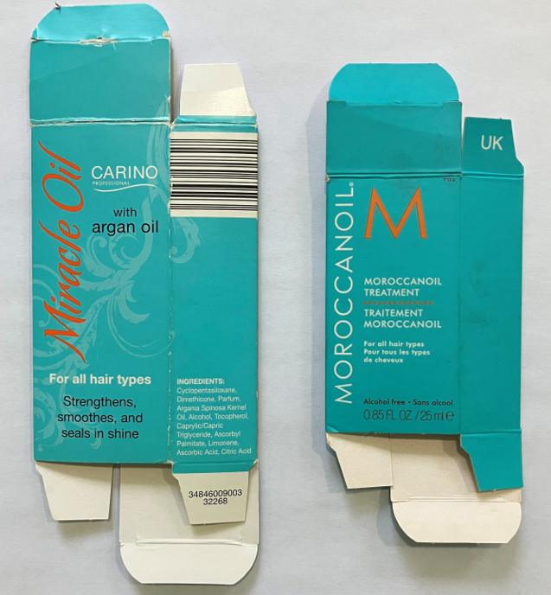
MoroccanOil v Aldi – argan hair oil
result: no deception, so no passing-off
Hungrey Hodophile: “To look at I was shocked by how similar the packaging is, they have used exactly the same shade of blue and orange with black and white writing in the same amber bottles with the same brown bottle screw cap. … , but I’ve not noticed any difference in quality.”

Slide 6
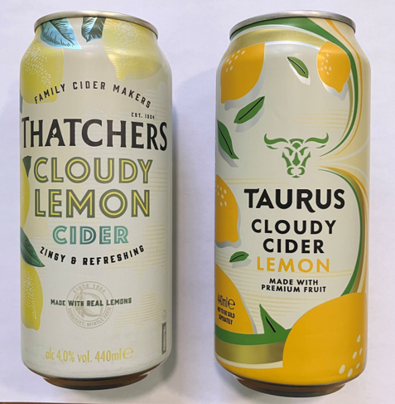

Thatchers v Aldi – cloudy lemon cider
result: no confusion, but unfair advantage of registered TM for the packaging – transfer of the image of the mark or its characteristics
UK №. 3 489 711

Slide 7
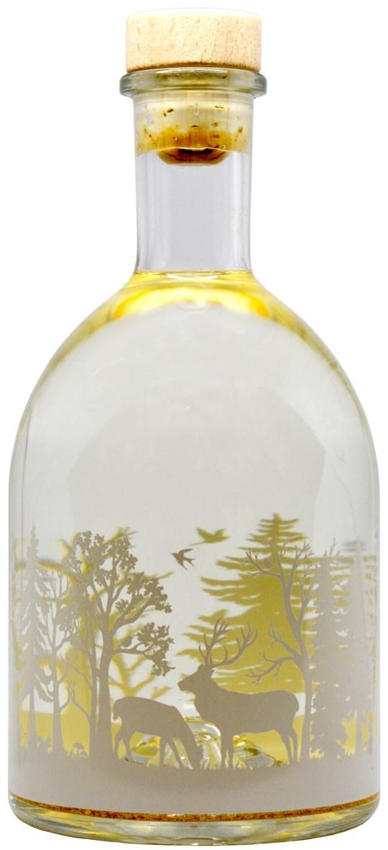
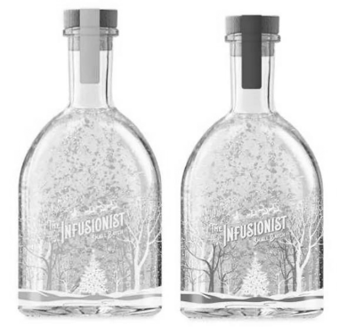
M&S v Aldi – Christmas glitter gin bottle
result: same overall impression
– case centred on what formed
the prior art, in particular disclosures
by the designer. M&S had no rights
in the bottle shape per se.

Slide 8
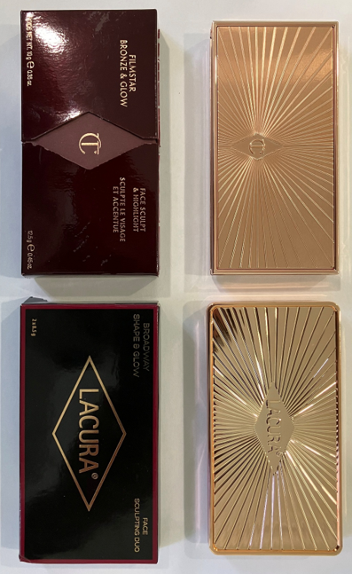
Islestarr v Aldi – make-up compact case
result: copyright infringement of the lid starburst design

Slide 9
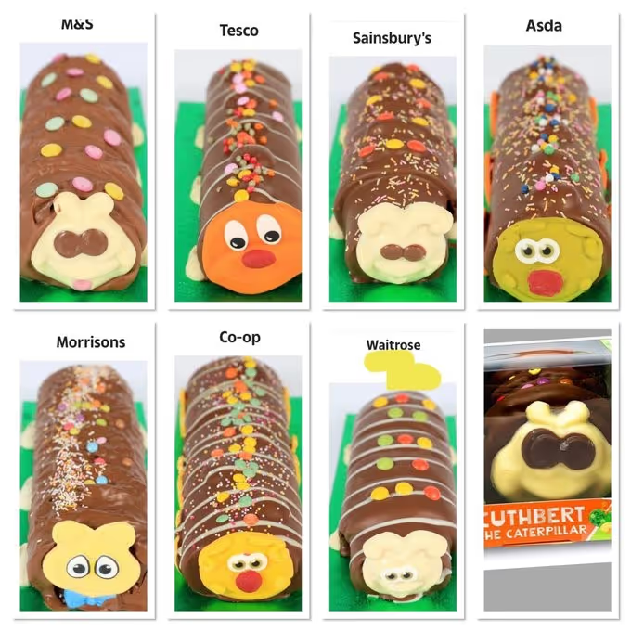
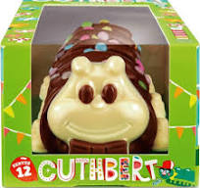
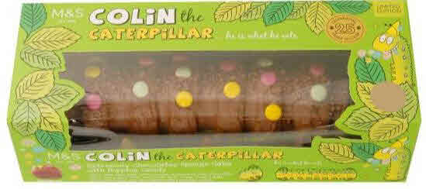
the Caterpillar wars: Colin vs Cuthbert
UK №. 2 499 694 Colin the Caterpillar
UK №. 3 509 740 packaging
goodwill in the name, packaging, product
Tesco – Curly; Asda – Clyde;
Co-op – Charlie; Waitrose – Cecil
result: settled, and Cuthbert still on sale

Slide 10


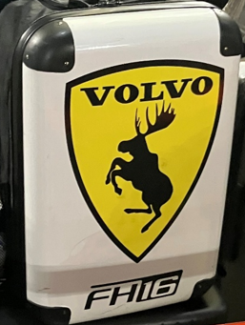
actionable – or just homage / in-joke?
with Italian flag
Scuderia Ferrari
FH16 – Forward control
High entry, 16 litre engine
with Swedish flag

Slide 11
some tentative conclusions
little or no deception as consumers aware of lookalikes (vs Jif Lemon), and often seek them out deliberately
little or no confusion as common elements generic
  commonality of generic or descriptive elements
unfair advantage shown by sales of goods
  commonality of non-reputed elements
copying of substantial part / similar overall impression
  copying of non-original elements

Slide 12




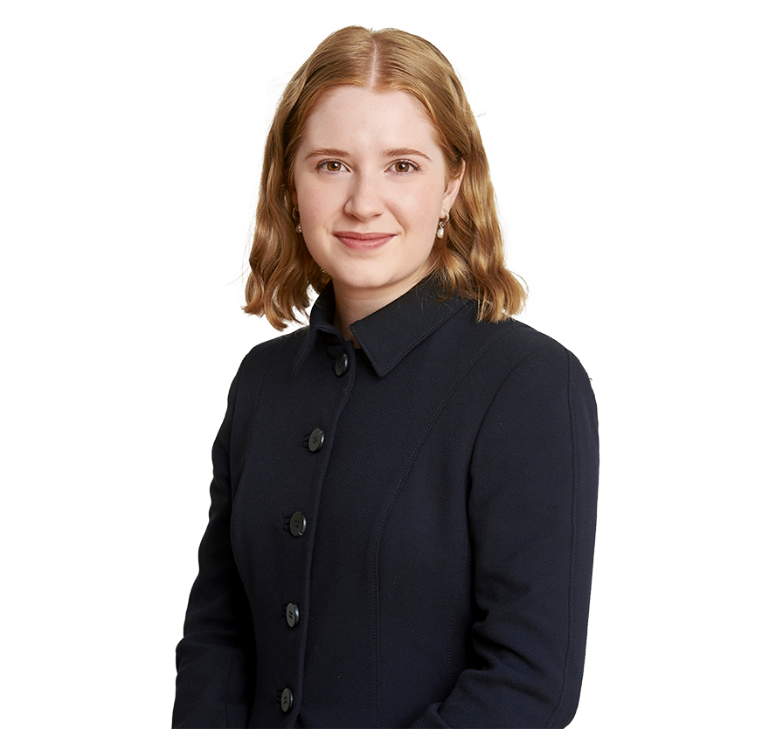



IP practitioners at Serle Court
Thomas Elias (2008) Adrian de Froment (2013) Stephanie Wickenden (2014) John Eldridge (2019)
Niamh Herrett (2021) Stefano Braschi (2021) Anneliese Mondschein (2021) Ryan Tang (2022)

Slide 13
Michael Edenborough KC
contact details:
  Serle Court, 6 New Square, Lincoln’s Inn, WC2A 3QS, UK
  (t) + 44 (0)20 7242 6105
  (e) MEdenborough@SerleCourt.co.uk
all areas of intellectual property law and practice, in particular: trade marks / geographical indications and passing-off; copyright / moral rights and designs; and, patents and confidential information
author of Contentious Trade Mark Registry Proceedings (2nd edition, along with Thomas Elias, Adrian de Froment and Stephanie Wickenden as contributors, and Niamh Herrett as index compiler – about 330,000 words resulting in lvii + 696 pages, October 2023, published by CITMA)

